Slide 1
What we learned from developing a dashboard in GOV.UK style using Quarto
Health Trends in England
December 2023

Slide 2
Health Trends in England
Aim: Develop and deliver a monthly population health surveillance output
Audience: Public health professionals, to help the public understand the key messages
Frequency: monthly report, topic areas with most recently updated data presented first
Data: use existing data from Fingertips
Geography: presented nationally and regionally
Measure of change: trend analysis, to identify areas of improvement and those areas where direction of travel is worsening

Slide 3
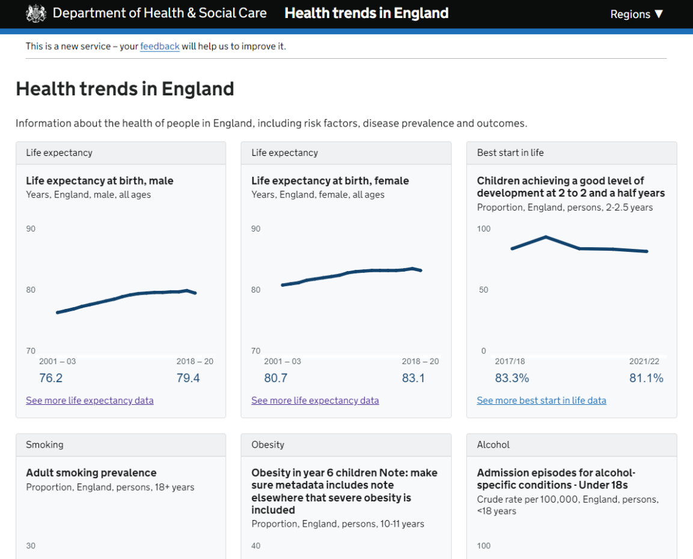
Health Trends in England - Alpha

Slide 4
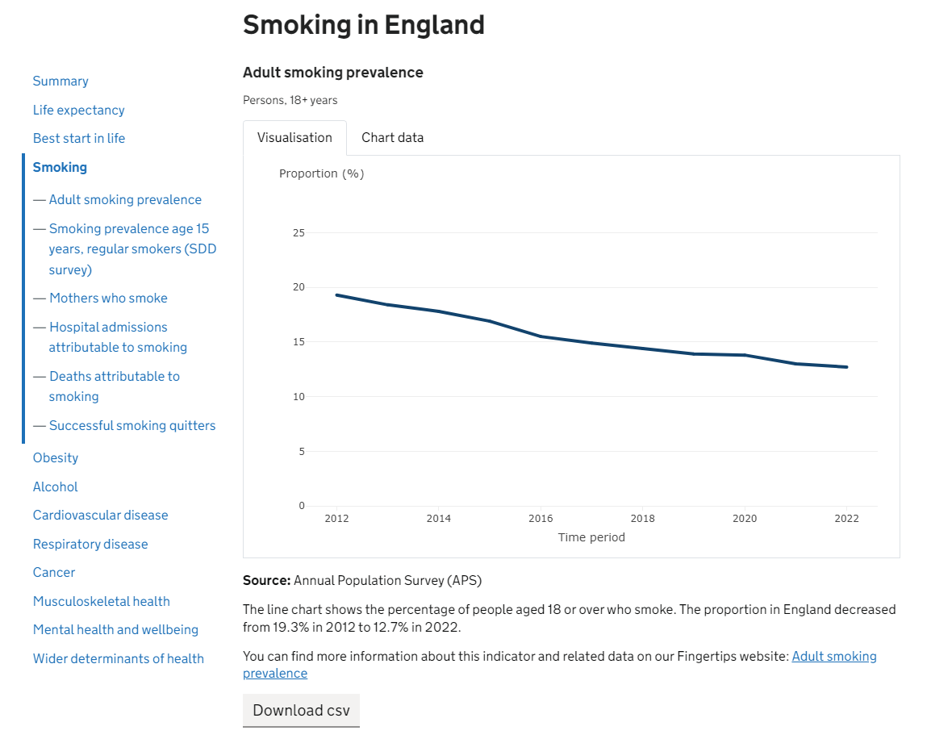
Health Trends in England - Alpha

Slide 5
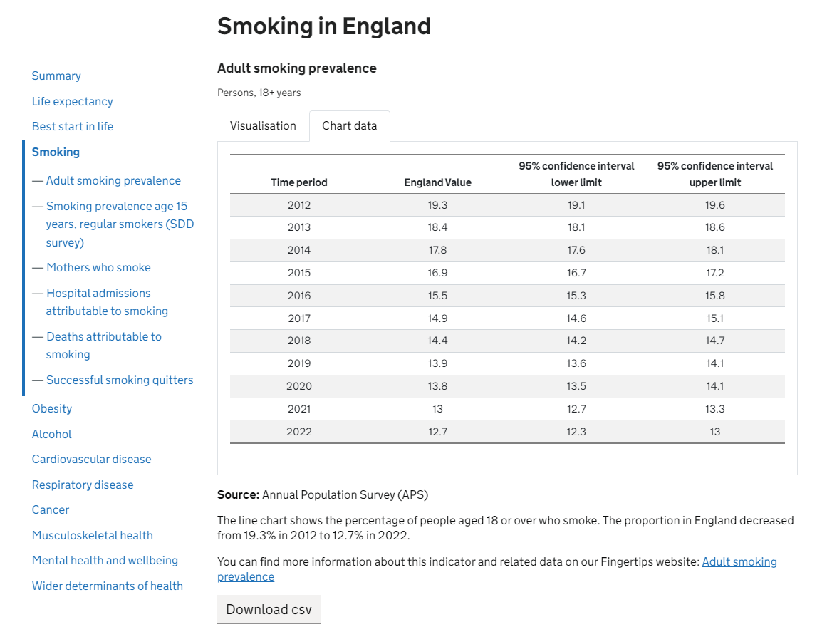
Monthly Surveillance Summary - Alpha

Slide 6
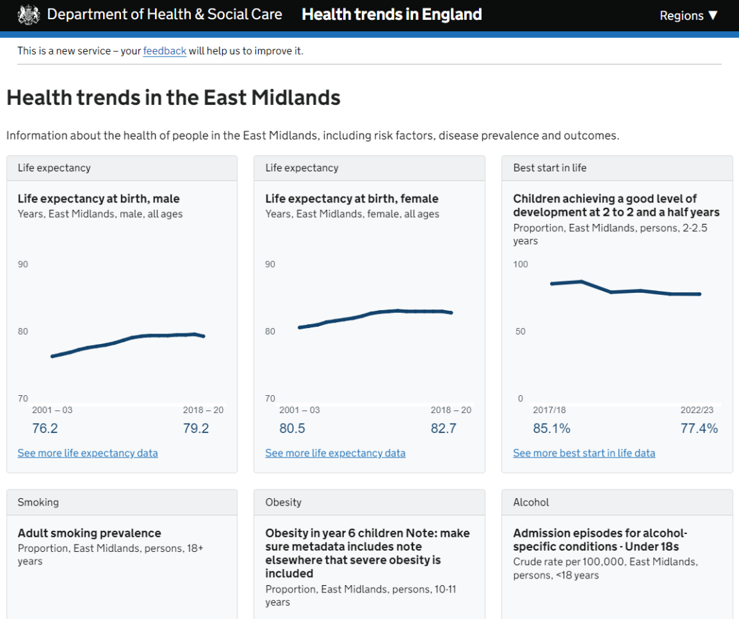
Monthly Surveillance Summary - Alpha

Slide 7
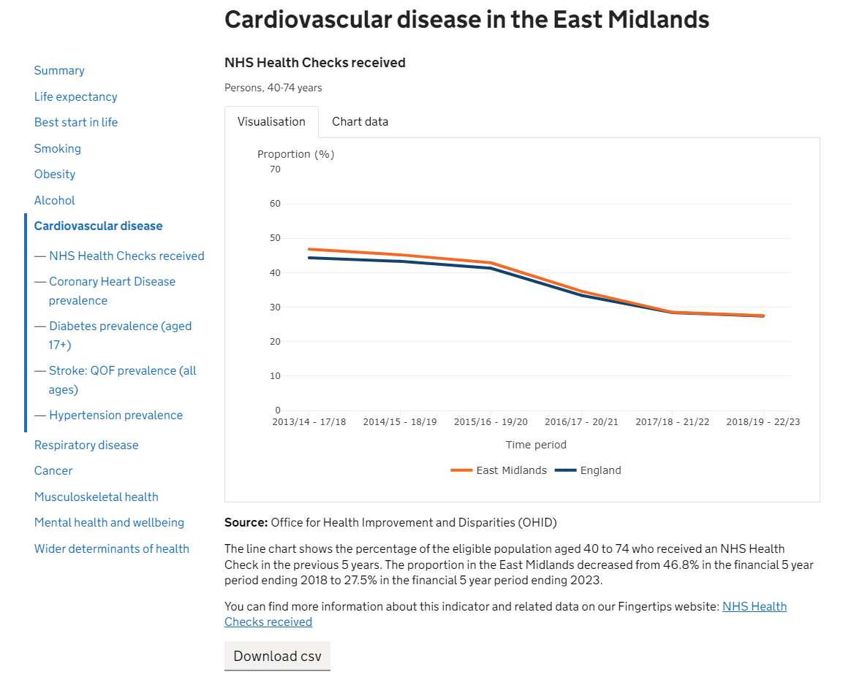
Monthly Surveillance Summary - Alpha

Slide 8
How we do it

Slide 9
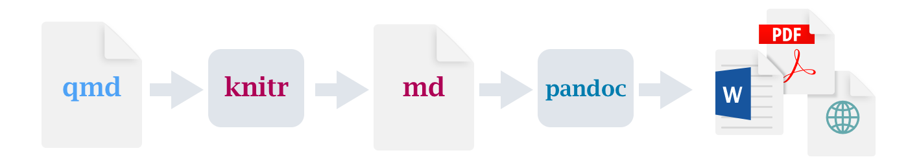
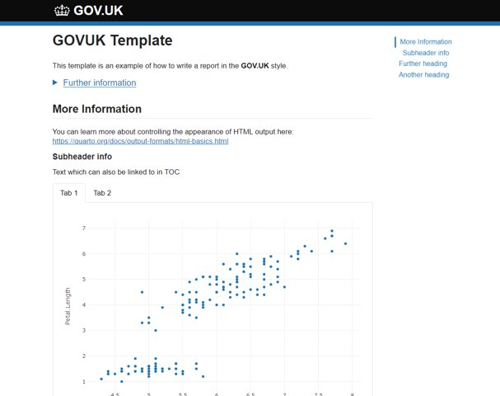
Quarto
Quarto is very similar to R Markdown
Can usually simply change .Rmd file to .qmd file and should run the same
How to use Quarto was covered in our last Coffee and Coding session
Quarto's FAQ for RMd users
Can write code in R and Python
As Quarto uses multiple engines (KnitR, Jupyter), unlike R Markdown
Supported IDEs: RStudio, VS Code, Jupyter Noteboks
Easier to create styled templates like our GOV.UK style templates
Covered in our last Coffee and Coding session

Slide 10
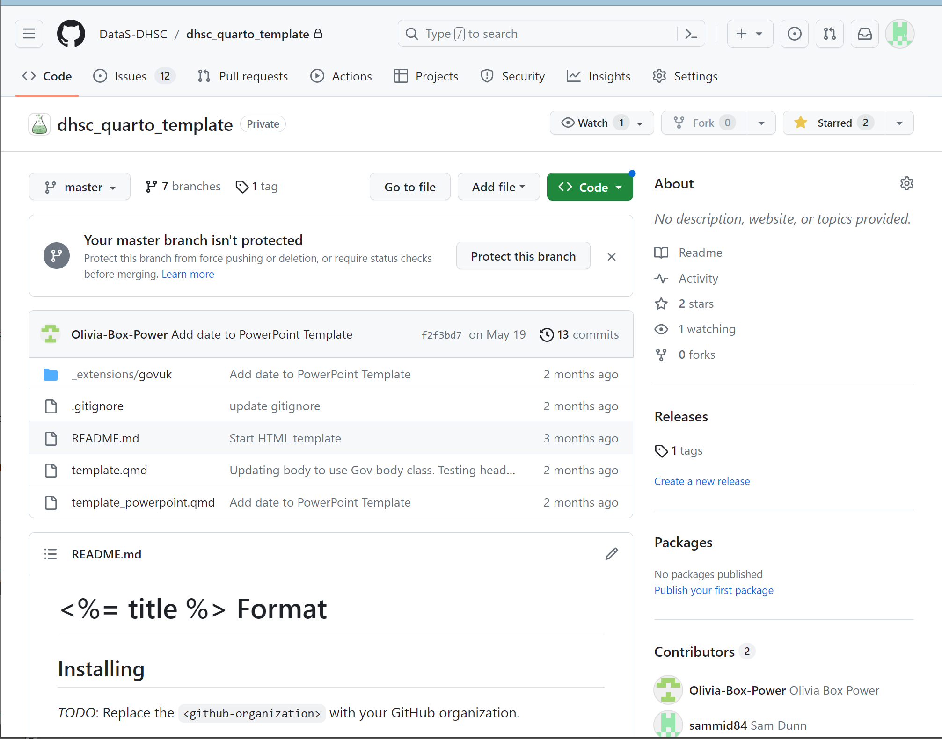
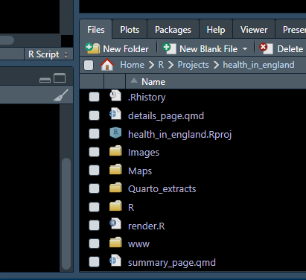
Quarto templates
To use our GOV.uk template, you can simply add the www folder to your project and link to it or use our whole Quarto template from GitHub

Slide 11
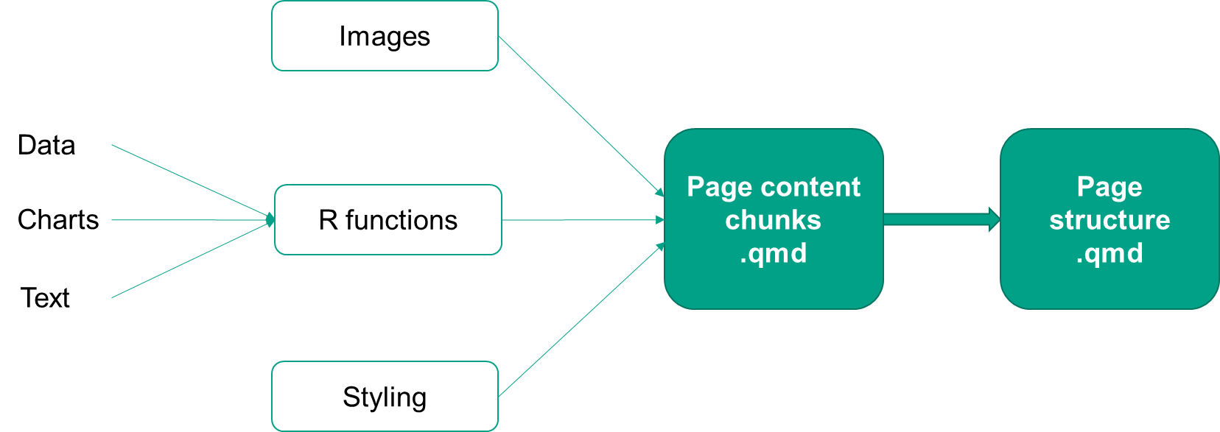
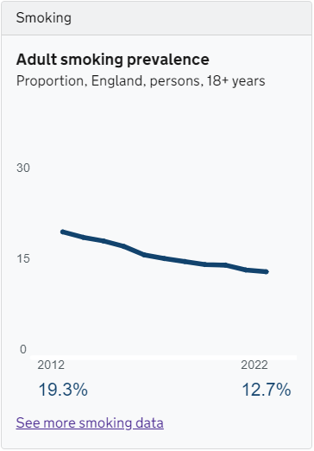
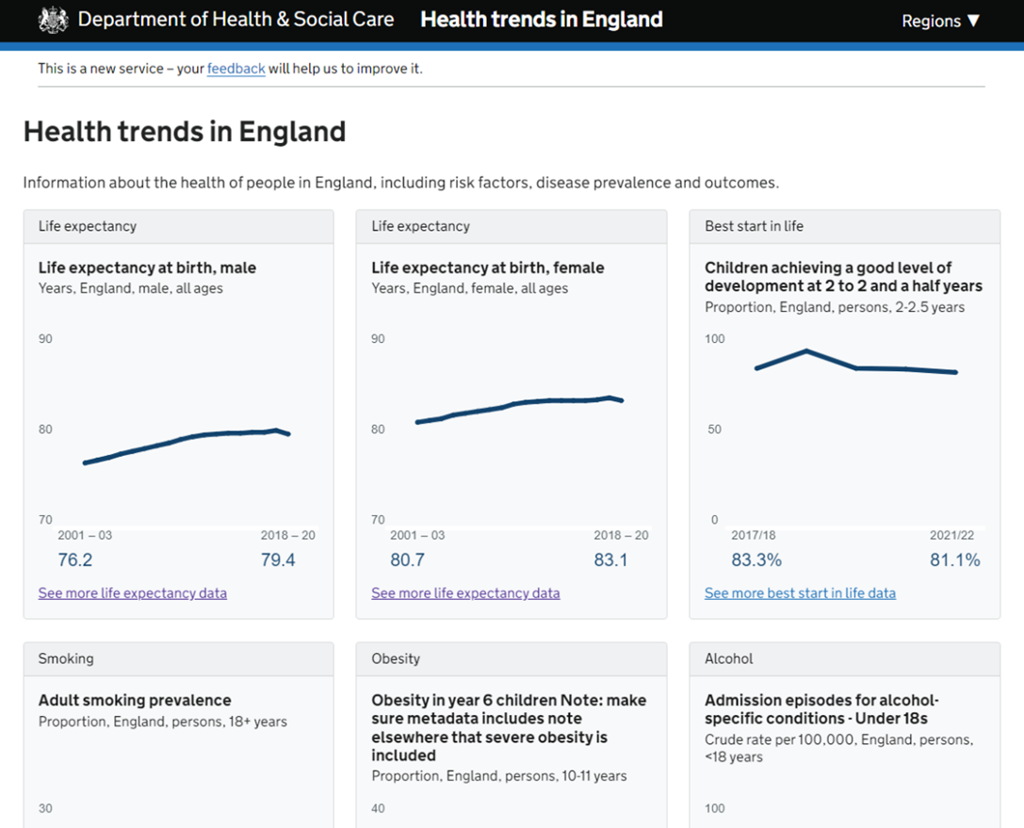

Project structure

Slide 12

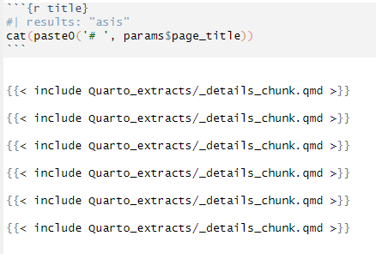
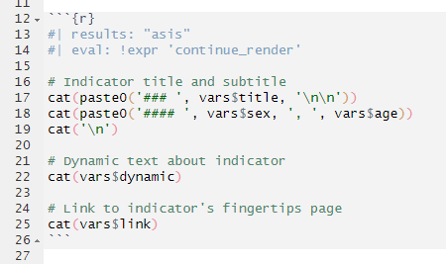
Conditional rendering
To avoid having a quarto file for every possible number of indicators, we used conditional rendering.
Object continue_render is set to TRUE, then changes to FALSE when there are no more indicators in the list.
In the page structure qmd file, we use include to pull through the sections of code for each indicator:
Example if there are 4 indicators in a group:
Eval is set to TRUE/FALSE to control whether the code runs or not. So the content code only runs when continue_render is TRUE.
TRUE
TRUE
TRUE
TRUE
FALSE
FALSE

Slide 13
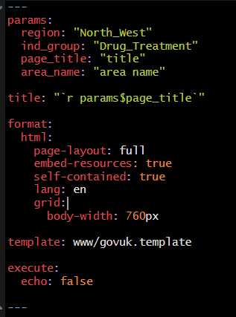
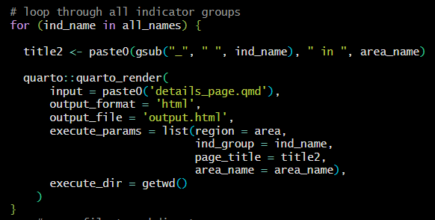
Parameterised rendering
To make the project fully automated, we used parameterised rendering (similar in RMarkdown) to loop through the various regions and indicator groups while using the same Quarto document
Specify the params in the YAML at the top of the Quarto doc
You can even reference params within the YAML and use defaults

Slide 14
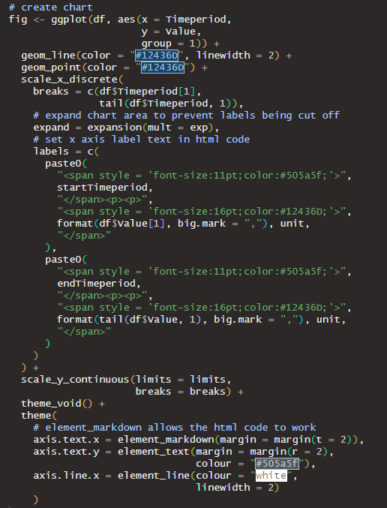
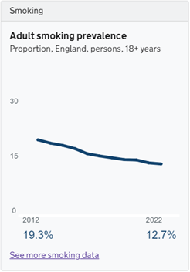
Summary chart: ggplot2

Slide 15
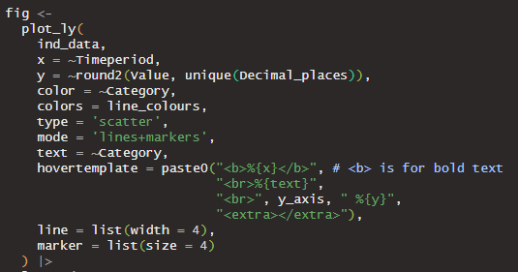
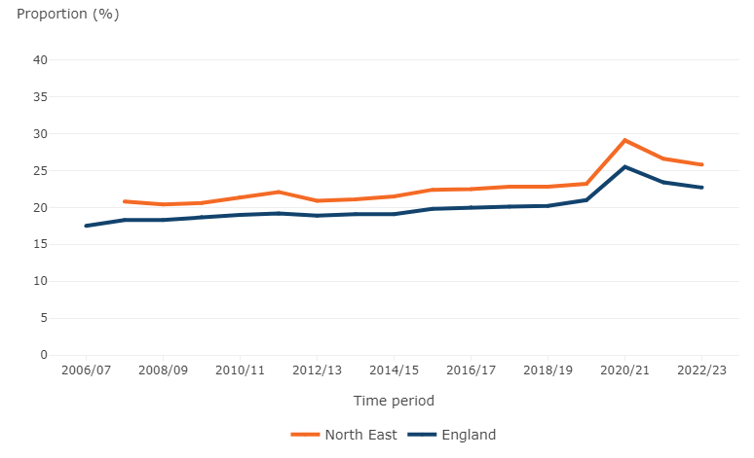
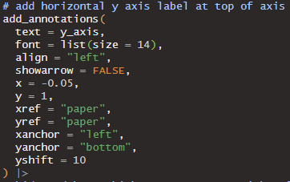
Details charts: plotly

Slide 16
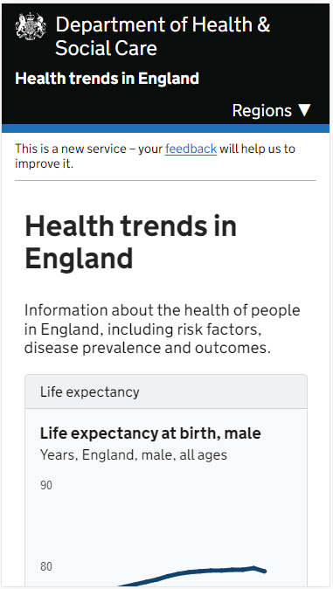
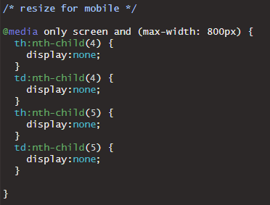
Mobile view
The tiles stack as the screen gets smaller, so that in mobile view there is one tile per row. To do this we used some features from Bootstrap, a CSS framework for developing mobile friendly websites:
Bootstrap’s cards
Bootstrap’s grid system
Drop table columns below a specified screen width:

Slide 17
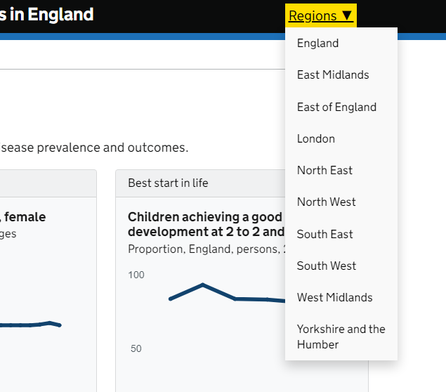
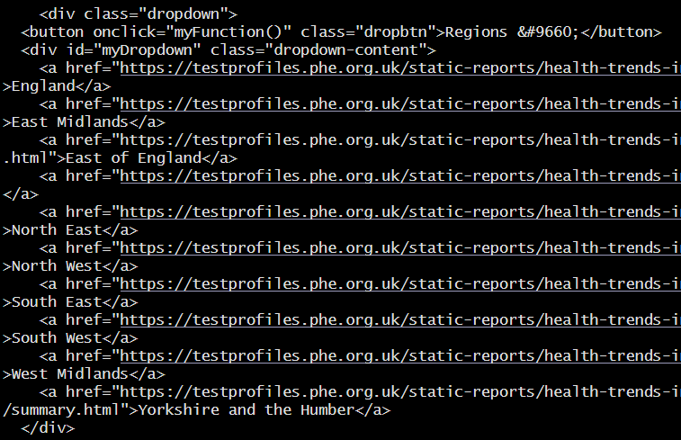
Region drop down in navbar - HTML in Pandoc

Slide 18
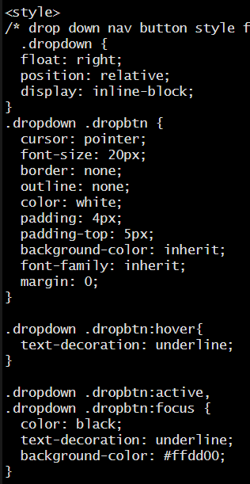
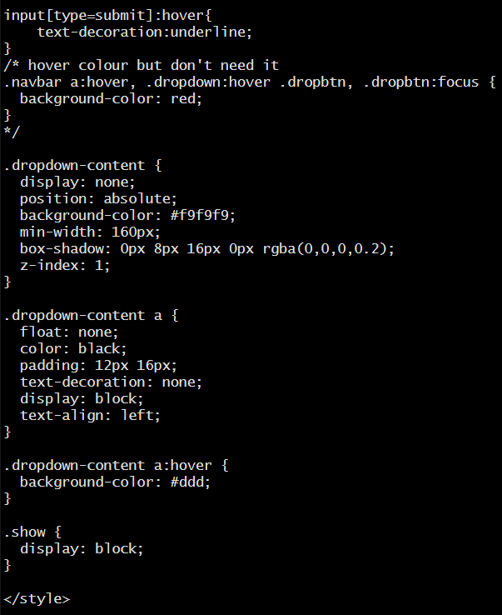
Region drop down in navbar - CSS

Slide 19
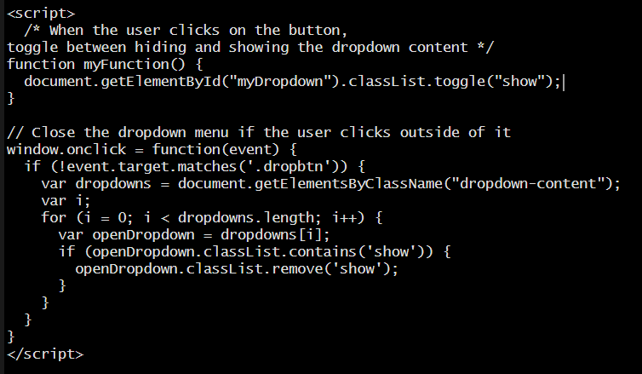
Region drop down in navbar - JavaScript

Slide 20
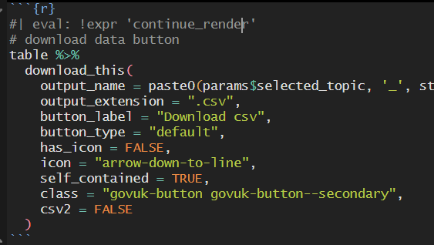
Accessibility
To meet accessibility success criterion 1.1.1 all non-text content should have alternative text that “serves the equivalent purpose”, which the Analysis Function says could be a data table, so like the Covid dashboard, we included a 'Chart data' tab with Quarto's {.panel-tabset}
There is also a data download button
For keyboard navigation (i.e. for those with motor disabilities) the summary page had lots of links which were confusing for a keyboard user to keep tabbing through, so adding the HTML attribute tabindex = -1 meant that we could remove unnecessary links

Slide 21
Feedback / Questions

